Slide 1

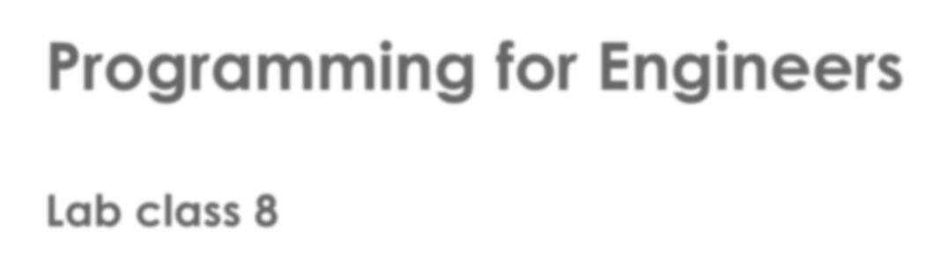
Programming for Engineers
Lab class 8

Slide 2

Previously
From C to C++
Some fundamental concepts in Object-orientation
 Abstraction and Modularisation
 Information hiding and encapsulation
 Interface and implementation
Designing programs
 The “linguistic” method for finding classes and methods
 Setting up a requirements specification

Slide 3

Today
More object-oriented modelling
 A quick look into inheritance and polymorphism in C++
Number bases and bitwise operations
 Binary vs. decimal vs. hexadecimal numbers
 Bitwise operations / operators

Slide 4
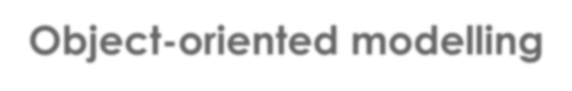
Object-oriented modelling
Inheritance
 A core concept in object-oriented programming
 Used to define relationships between classes (is-a structure)
 Allows for effective code reuse
 Makes extending existing code much easier

Slide 5
Object-oriented modelling
Inheritance: Example
A Database of Multimedia Entertainment (DoME)
 Stores details about CDs and videos
 CD: title, artist, tracks, playing time, got-it, comment
 Video: title, director, playing time, got-it, comment
 Later, it should allow users to search for information or print lists

Slide 6
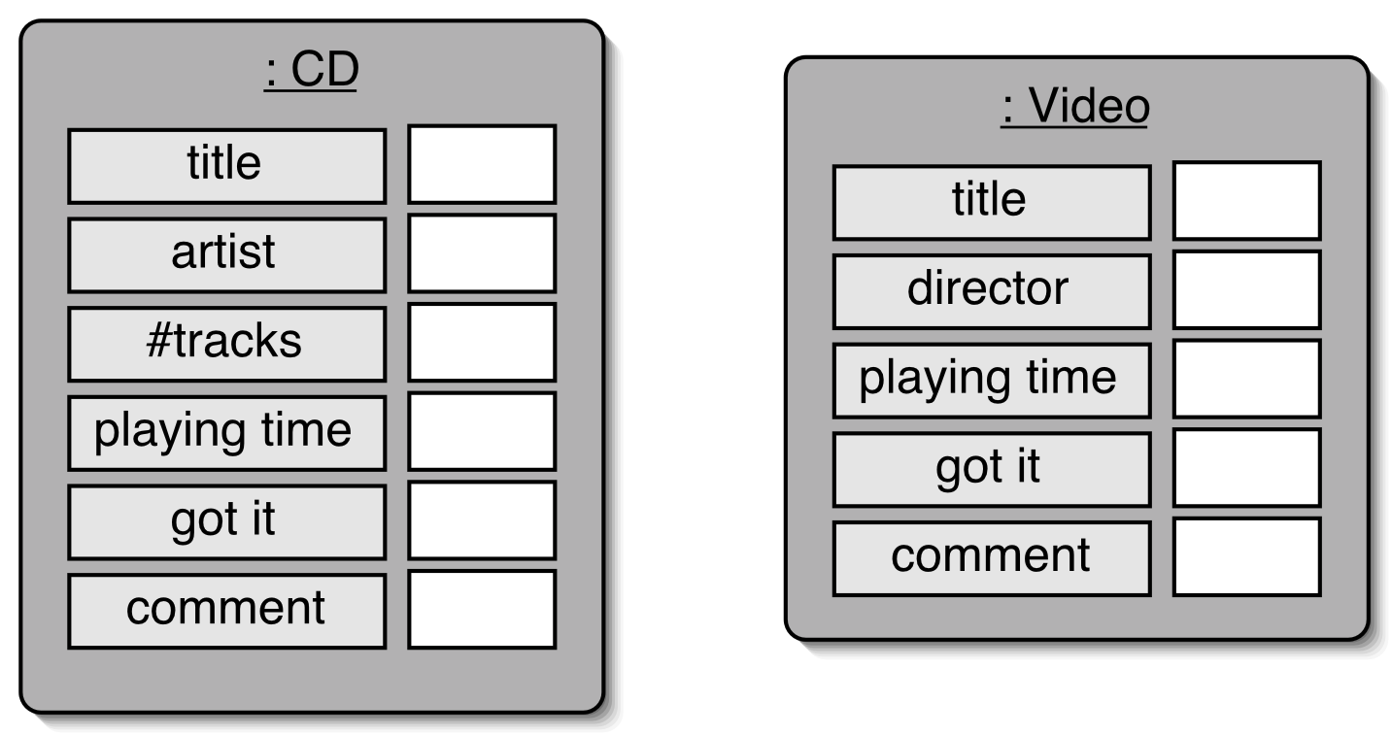
Object-oriented modelling
DoME
 Objects

Slide 7
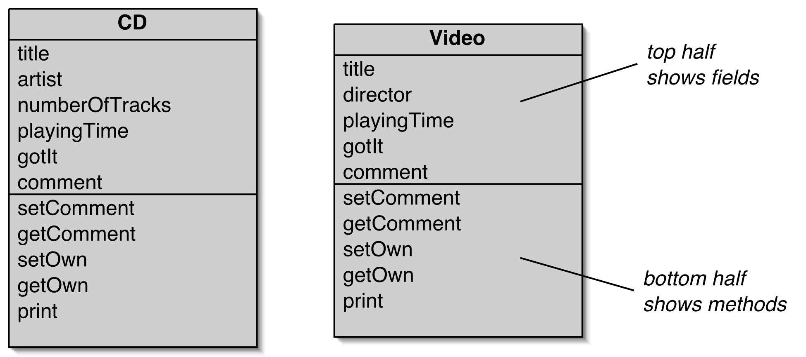
Object-oriented modelling
DoME
 Classes

Slide 8
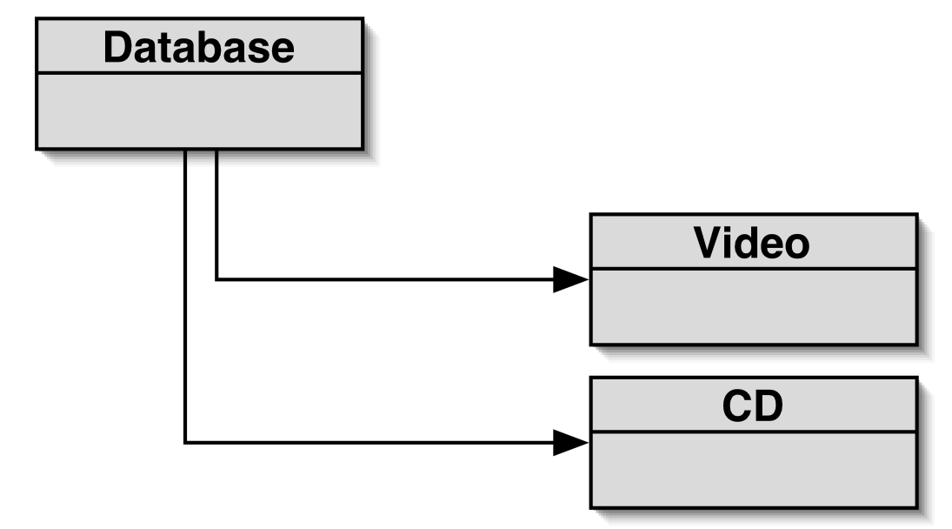
Object-oriented modelling
DoME
 Class Diagram

Slide 9
Object-oriented modelling
#include <iostream> #include <string> using namespace std;
class CD {
private: string title;
string artist; int rating;
public:
// constructor CD() {}
// getters and setters, e.g.
int getRating() {}
// print info void print() {}
};
DoME
 CD class

Slide 10
Object-oriented modelling
#include <iostream> #include <string> using namespace std;
class Video {
private: string title;
string director; int rating;
public:
// constructor Video() {}
// getters and setters, e.g.
int getRating() {}
// print info void print() {}
};
DoME
 Video class

Slide 11
Object-oriented modelling
#include <iostream> using namespace std;
class Database {
private:
// collections for CDs and Videos vector<CD> cds;
vector<Video> videos;
public:
// function to list all items in the database void list() {
for(int i=0; i< cds.size();i++) {
cds[i].print(); }
for(int i=0; i< videos.size();i++) { videos[i].print(); }
}
};
DoME
 Database class

Slide 12
Object-oriented modelling
DoME - Criticisms
 A lot of code duplication – the CD and Video classes are largely identical
 This makes maintenance difficult and laborious
 Introduces danger of bugs through incorrect maintenance
 Code duplication continues in the Database class

Slide 13
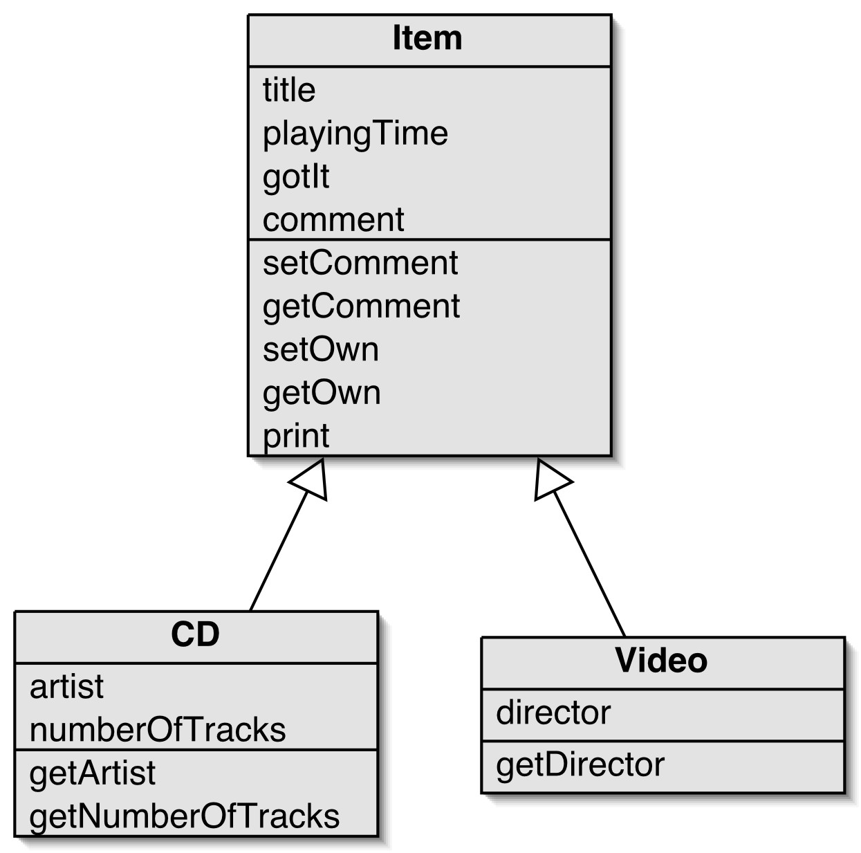
Object-oriented modelling
Improving DoME with Inheritance
Superclass
 Define a superclass : Item
 The superclass defines common attributes
 Define subclasses for CD and Video
 The subclasses inherit the superclass attributes
 The subclasses can add their own attributes
Inheritance
Subclass
Subclass

Slide 14
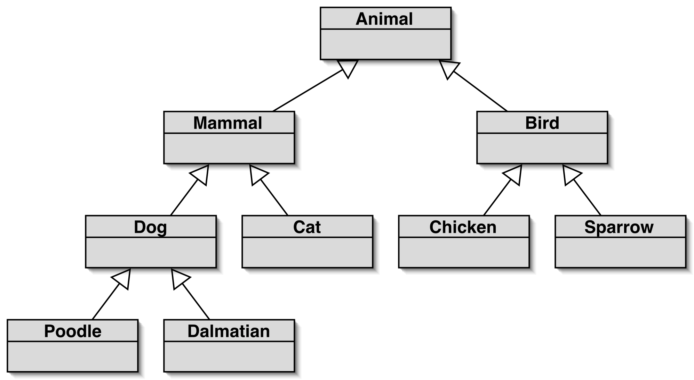
Object-oriented modelling
How do Inheritance Hierarchies Work?
 Similar to taxonomies
Inheritance establishes an is-a relationship between classes

Slide 15

Inheritance
The derived classes “inherit” data and behaviour of the base class.
Base class
class Item
{
...
}
Inheritance
Derived class
Derived class
class CD : public Item
{
...
}
class Video : public Item {
...
}

Slide 16
Inheritance
Base class
#include <iostream> #include <string> using namespace std;
class Item {
private:
string title; int rating;
public:
// constructor
Item() {}
// getters and setters, e.g
int getTitle() {}
};
Derived class
#include <iostream> #include <string> using namespace std;
class CD : public Item {
private:
string artist; public:
// class-spec. functions
void getTracks() {}
};
The derived class can directly access all non-private elements of the base class

Slide 17
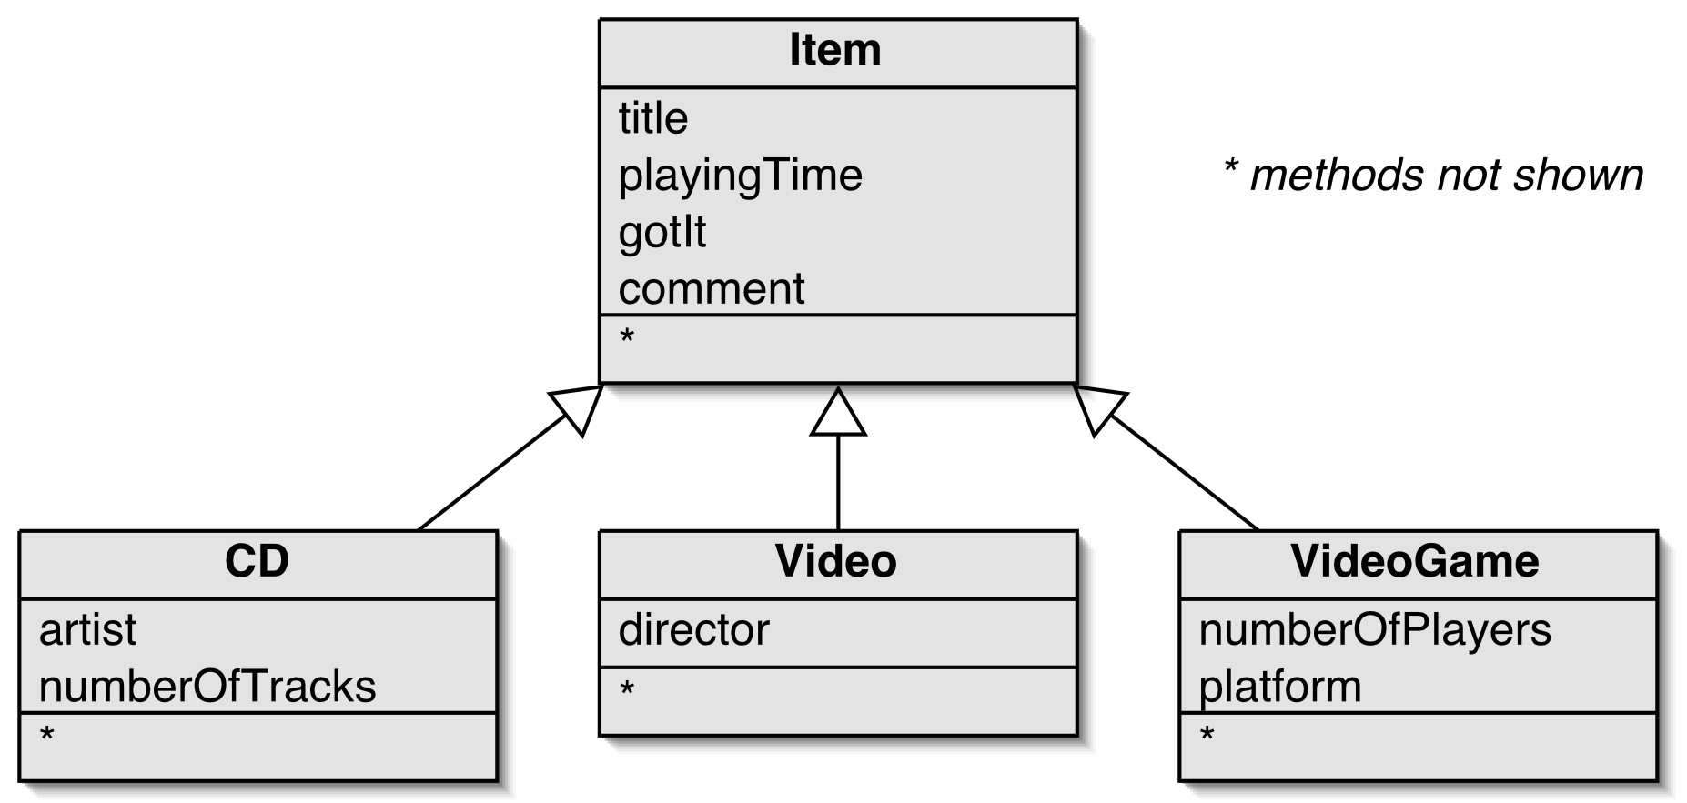
Inheritance
Adding more subclasses

Slide 18
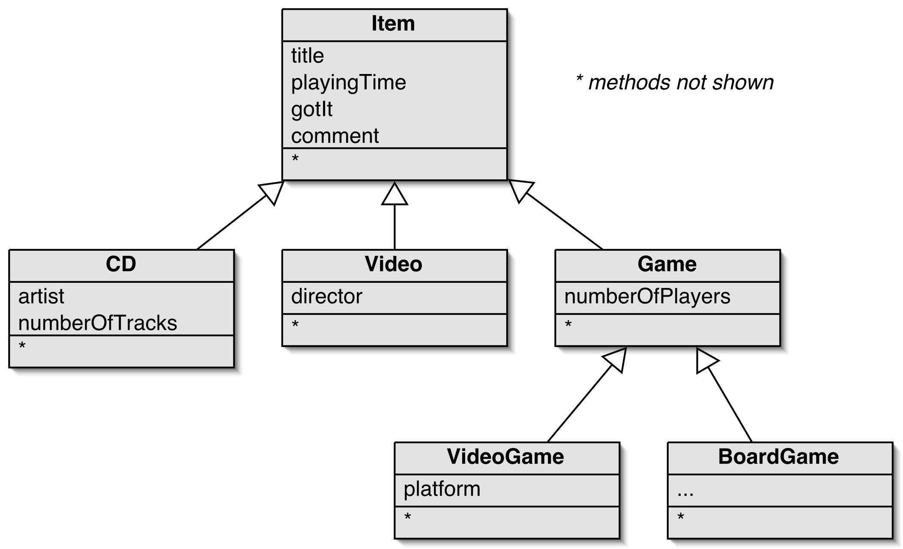
Inheritance
Deeper Hierarchies

Slide 19
Inheritance
Inheritance – Key points
 Allows the definition of derived (sub-)classes as extensions of other classes
 Implements a “Sub-object is-a Super object“ relationship
 Structures the code effectively
 Avoids code duplication
 Allows code reuse
 Simplifies maintenance

Slide 20

Polymorphism
Objects defined within a class hierarchy may exhibit different behaviour
When we compile the code or
 During runtime

Slide 21
Polymorphism
An example for compile-time polymorphism is the “overloading” of functions
 When we have two functions of the same name but with different parameter lists
class Item { main() {
// <data members>
Item i1;
public:
// constructors Item() {}
Item i2(“Greatest hits”);
}
Item(string title) {}
};
 The constructor to be used will be decided during compile time

Slide 22
Polymorphism
An example for run-time polymorphism is the “overriding” of functions
When we have two functions of the same name in classes that have an inheritance relationship
class Item {
// <data members> public: void print() {}
};
class CD : public Item {
// <data members> public:
void print() {}
};
If we create a CD object (e.g., cd) and then call cd.print() during runtime , the function defined in the derived class will be executed over that in the base class.
To call the function in the base class, we need to use the scope operator (::)

Slide 23

Summary
Polymorphism – Key points
 Polymorphism allows for effective modularisation of code
 Helps avoid code duplication
 Allows code reuse (base class)
 Simplifies maintenance
 Inheritance and polymorphism are important object-oriented modelling mechanisms
There are many more aspects to these concepts that we cannot cover in this module (e.g., multiple inheritance, sub-typing, abstract classes, etc.)

Slide 24

Number bases
Different number bases – why?
 Let’s look at different hierarchy levels of a computer system:
 We program in higher-level languages using alpha-numerical symbols.
 If there is any maths involved, we tend to express real-world tasks and problems in the
number system we’re most familiar with: decimal.
 Ultimately, all programs and all data are represented as binary bit patterns
 Data and programs are stored in memory in a binary format
 CPU information processing is performed by binary operations
 Memory addresses and large binary numbers are often expressed as hexadecimal numbers
 For a good programmer, using and converting between different number bases is an
essential skill

Slide 25
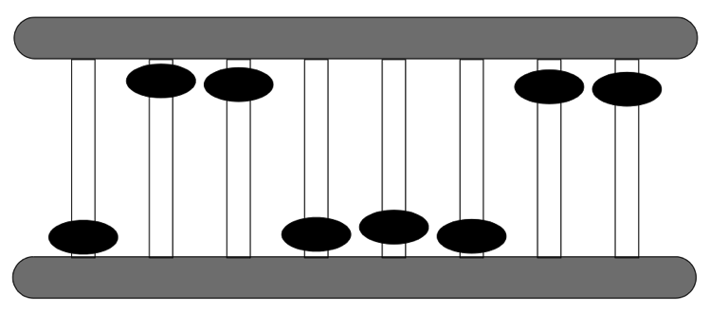
Number bases
Bit patterns
 What is a bit?
Consider beads on a frame. Each bead is in one of two states: up or down.
This frame has 8 beads in a fixed pattern. It can store 8 bits of information. How many different states can it be in?

Slide 26
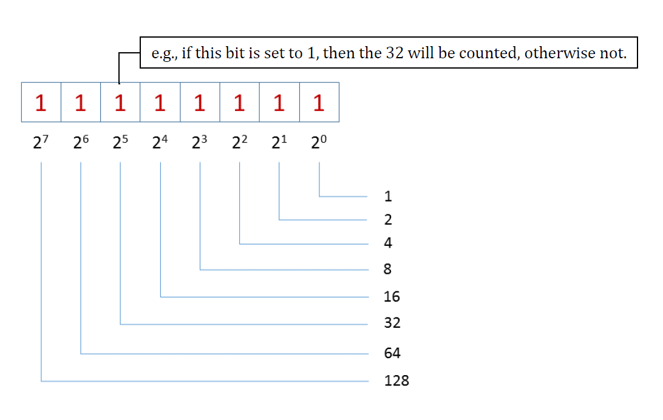
Number bases
Binary numbers
All bits in a binary number represent increasing powers of 2, starting with 2⁰ from right to left
We can convert bit patterns to decimal numbers, e.g. the 8-bit number 11111111 could be interpreted like this:
If a bit is switched “on” (1), then the value that this bit represents counts towards the total represented by the entire pattern.
2^{bits} = states, e.g.:
2⁸ = 2*2*2*2*2*2*2*2 = 256 possible states

Slide 27
Number bases
Decimal numbers
In decimal, we organise our numbers into powers of ten, i.e. units of ones, tens,
hundreds, and so on.
For example, the number 5617:
Thousands 1000s | Hundreds 100s | Tens 10s | Ones 1s
10³ | 10² | 10¹ | 10⁰
5 | 6 | 1 | 7
5 * 1000 + 6 * 100 + 1 * 10 + 7 * 1

Slide 28
Number bases
Binary numbers
 In binary, the number 5617 translates to 1 0 1 0 1 1 1 1 1 0 0 0 1
 All bits in a binary number represent increasing decimal powers of 2, starting with
2⁰ from right (the least significant bit) to left (towards the most significant bit)
4096 | 2048 | 1024 | 512 | 256 | 128 | 64 | 32 | 16 | 8 | 4 | 2 | 1
₂12 | ₂11 | ₂10 | ₂9 | ₂8 | ₂7 | ₂6 | ₂5 | ₂4 | ₂3 | ₂2 | ₂1 | ₂0
1 | 0 | 1 | 0 | 1 | 1 | 1 | 1 | 1 | 0 | 0 | 0 | 1
1 * 4096 + 0 * 2048 + 1 * 1024 + 0 * 512 + 1 * 256 + 1 * 128 + 1 * 64 + 1 * 32 + 1 * 16 + 0 *
8 + 0 * 4 + 0 * 2 + 1 * 1, or in short:
4096 + 1024 + 256 + 128 + 64 + 32 + 16 + 1

Slide 29
Number bases
Hexadecimal
 Each hex-digit represents a 4-bit binary number (0000₂ to 1111₂) or the decimal
numbers 0 to 16 (decimal values 10 - 16 are mapped to the letters A - F)
 In hexadecimal, the number 5617₁₀ (or 1010111110001₂) translates to:
4096s | 256s | 16s | 1s
16³ | 16² | 16¹ | 16⁰
1 | 5 | F | 1
1 * 4096 + 5 * 256 + F(=15₁₀) * 16 + 1 * 1

Slide 30

Practice time
Binary numbers
Create a program that takes as input a binary number of 8 bits length.
The output of the program should be the unsigned decimal integer equivalent of
this number.

Slide 31

Bitwise operations
Decimal | Binary | Hexadecimal
0 | 00000000 | 00
1 | 00000001 | 01
2 | 00000010 | 02
3 | 00000011 | 03
4 | 00000100 | 04
5 | 00000101 | 05
6 | 00000110 | 06
7 | 00000111 | 07
8 | 00001000 | 08
9 | 00001001 | 09
10 | 00001010 | 0A
11 | 00001011 | 0B
12 | 00001100 | 0C
13 | 00001101 | 0D
14 | 00001110 | 0E
15 | 00001111 | 0F
16 | 00010000 | 10
Bitwise operations
Knowing that data is stored in binary, we can manipulate bit patterns directly to perform certain types of computation

Slide 32
Bitwise operations
Decimal | Binary | Hexadecimal
0 | 00000000 | 00
1 | 00000001 | 01
2 | 00000010 | 02
3 | 00000011 | 03
4 | 00000100 | 04
5 | 00000101 | 05
6 | 00000110 | 06
7 | 00000111 | 07
8 | 00001000 | 08
9 | 00001001 | 09
10 | 00001010 | 0A
11 | 00001011 | 0B
12 | 00001100 | 0C
13 | 00001101 | 0D
14 | 00001110 | 0E
15 | 00001111 | 0F
16 | 00010000 | 10
Multiplication
Knowing that data is stored in binary, we can manipulate bit patterns directly to perform certain types of computation
E.g.,
Shifting bits to the left: multiply with 2

Slide 33
Bitwise operations
Decimal | Binary | Hexadecimal
0 | 00000000 | 00
1 | 00000001 | 01
2 | 00000010 | 02
3 | 00000011 | 03
4 | 00000100 | 04
5 | 00000101 | 05
6 | 00000110 | 06
7 | 00000111 | 07
8 | 00001000 | 08
9 | 00001001 | 09
10 | 00001010 | 0A
11 | 00001011 | 0B
12 | 00001100 | 0C
13 | 00001101 | 0D
14 | 00001110 | 0E
15 | 00001111 | 0F
16 | 00010000 | 10
Division
Knowing that data is stored in binary, we can manipulate bit patterns directly to perform certain types of computation
 E.g.,
Shifting bits to the left: multiply with 2
Shifting bits to the right: divide by 2

Slide 34
Bitwise operations
Decimal | Binary | Hexadecimal
0 | 00000000 | 00
1 | 00000001 | 01
2 | 00000010 | 02
3 | 00000011 | 03
4 | 00000100 | 04
5 | 00000101 | 05
6 | 00000110 | 06
7 | 00000111 | 07
8 | 00001000 | 08
9 | 00001001 | 09
10 | 00001010 | 0A
11 | 00001011 | 0B
12 | 00001100 | 0C
13 | 00001101 | 0D
14 | 00001110 | 0E
15 | 00001111 | 0F
16 | 00010000 | 10
Logic operations
Knowing that data is stored in binary, we can manipulate bit patterns directly to perform certain types of computation
 E.g.,
Shifting bits to the left: multiply with 2
Shifting bits to the right: divide by 2
Logic operations: XOR, AND, OR…
(may require two numbers as input)

Slide 35
Bitwise operations
Logic operations
 Logic operations are carried out bit by bit
from right to left
AND will yield 1 only if both inputs are 1.
OR will yield 1 only if either of the inputs are 1, or both are 1
XOR will yield 1 only if either of the inputs are 1, but not both
NOT will simply negate the current truth value of each bit
 | Binary
 | 00000010
AND | 00000011
 | 00000010
 | Binary
 | 00000010
OR | 00000011
 | 00000011
 | Binary
 | 00000010
XOR | 00000011
 | 00000001
 | Binary
NOT | 00000010
 | 11111101

Slide 36

More operators
Bitwise operators in C
Expression | What does it do? | Example
x & y | Logical bitwise x AND y | 1010 & 0110 -> 0010
x | y | Logical bitwise x OR y | 1010 | 0110 -> 1110
x ^ y | Logical bitwise x XOR y | 1010 ^ 0110 -> 1100
~ x | Logical bitwise NOT x | ~1010 -> 0101
x << n | Bitwise left-shift by n bits | 0110 << 1 -> 1100
x >> n | Bitwise right-shift by n bits | 0110 >> 1 -> 0011

Slide 37
Practice time
Bitwise operations
Create a simple program that takes as input a decimal number and stores this in an
integer variable x.
Then use the correct bit shift operators to
multiply x by 8
divide x by 2
and output these numbers on screen.

Slide 38

Next Lab
Basics of low-level programming
Introduction to computer architectures
Machine language programming
A brief glance at assembly language (time permitting)

